Slide 1
FACE RECOGNITION AND IDENTIFICATION
USING MACHINE LEARNING

Slide 2
TEAM MEMBERS
17BCE0278 ABHISHEK THOMAS
17BCE0211 NACHI MUTHU
17BCE0012 SAI SAATHVIK
17BCE0191 ALLEN BIJU THOMAS

Slide 3
WHAT IS BIOMETRICS ?
“A biometric is a physiological or behavioral characteristic
of a human being that can distinguish one person from
another and that theoretically can be used for identification
or verification of identity.”
Biometric applications available today arecategorized into 2 sectors
▪ Psychological : Iris, Fingerprints, Hand, Retinal and Face Recognition
▪ Behavioral : Voice, Typing pattern, Signature

Slide 4
Face Recognition
Face recognition systems (FRSs) are an important field in computer vision, because it represent a non-invasive BI technique.
1. A face detection algorithm is used for extracting faces from video frames (training videos) and generating a face database.
2. Filtering and preprocessing are applied to face images obtained in the previous step.
3. A collection of machine learning algorithms are trained using as input data the faces obtained in the previous step.
4. Finally, the classifiers are used for classify faces obtained from video frames

Slide 5
FACE RECOGNITION Process
For face recognition there are two types of comparisons-
◆ 1. Verification.
This is where the system compares the given individual with who that individual says
they are and gives a yes or no decision.
◆ 2. Identification.
This is where the system compares the given individual to all the Other individuals in the
database and gives a ranked list of matches.

Slide 6
All identification or authentication technologies operate using the following four stages:
◆ a. Capture: A physical or behavioral sample is captured by the system during
Enrollment and also in identification or verification process
◆ b. Extraction: Unique data is extracted from the sample and a template is created.
◆ c. Comparison: The template is then compared with a new sample.
◆ d. Match/ Non-Match : The system decides if the features extracted from the new Samples are a match or a non match.

Slide 7
COMPONENTS OF FACE RECOGNITION SYSTEMS
a. Enrollment module : An automated mechanism that scans and captures a
digital or an analog image of a living personal characteristics
◆ b. Database : Another entity which handles compression, processing, storage
and compression of the captured data with stored data
◆ c. Identification module : The third interfaces with the application system

Slide 8
The method we used
In this project we have used dlib and face_recognition
These models implement deep metric model and triplet model.
ResNet-34 is the CNN model used.

Slide 9
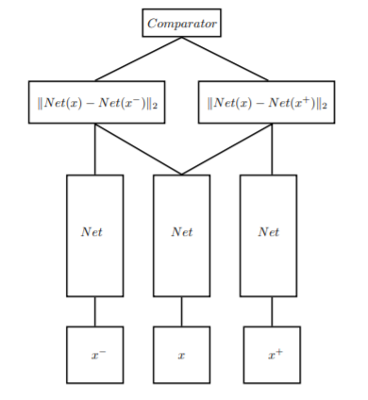
Deep metric learning and triplet model

Slide 10
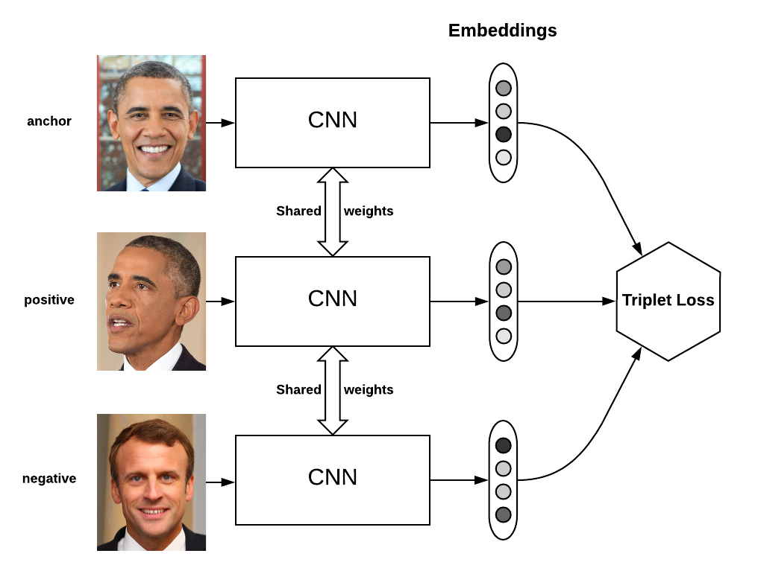
Example

Slide 11
Implementation
The implementation of face recognition technology includes the following four stages:
• Image acquisition
• Image processing
• Generating 128D vector
• Modifying the existing vectors
• Vector Matching

Slide 12
Image ACQUISITON
Facial-scan technology can acquire faces from almost any static camera or video system that generates images of sufficient quality and resolution.
High-quality enrollment is essential to eventual verification and identification enrolment images define the facial characteristics to be used in all future authentication events.

Slide 13
Image Processing
Images are cropped such that the ovoid facial image remains, and color images are normally converted to black and white in order to facilitate initial comparisons based on grayscale characteristics.
First the presence of faces or face in a scene must be detected. Once the face is detected, it must be localized and Normalization process may be required to bring the dimensions of the live facial sample in alignment with the one on the template

Slide 14
ALGORITHM
Open folder with dataset
Load all the images and add the folder names as labels for images
Pre-process the images and find the face locations
Extract the face
Generate 128D vector with respect to the face using face_recognition package
Modify the pre existing vectors
Complete training
Load test image
Generate 128D vector
Compare with existing vectors and identify the class of the image

Slide 15
WORKING EXAMPLES

Slide 16
Applications
Security/Counterterrorism. Access control, comparing surveillance images to Know terrorist.
▪ Day Care: Verify identity of individuals picking up the children.
▪ Residential Security: Alert homeowners of approaching personnel
▪ Voter verification: Where eligible politicians are required to verify their identity during a voting process this is intended to stop voting where the vote may not go as expected.
▪ Banking using ATM: The software is able to quickly verify a customer’s face.

Slide 17
Conclusion
This technique evaluate the suitability of both computer vision and ML techniques for solving the problem of face detection and recognition. Face recognition technologies have been associated generally with very costly top secure applications. Today the core technologies have evolved and the cost of equipment’s is going down dramatically due to the integration and the increasing processing power.

Slide 18
THANK YOU

